Slide 1

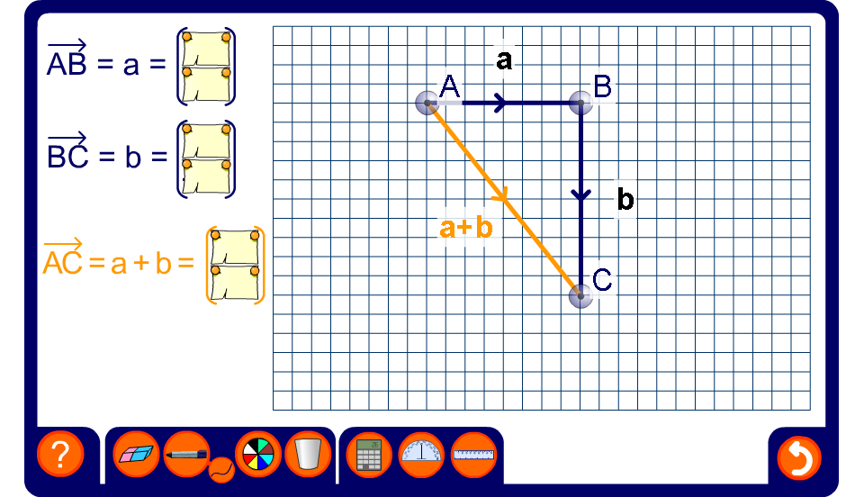


Adding vectors
Notes:
Stress that going from A to B to C is the same as going from A to C directly. This is often called the triangle law.
The horizontal and vertical components of each vector can be hidden if required.

